Slide 1
Software Design and Architecture
Instructor: Ms. Sonia Rafaqat

Slide 2
Design
Design:
A design is a plan or specification for the construction of an object or system or for the implementation of an activity or process or the result of that plan or specification in the form of a prototype, product, or process.
Software design is the process of envisioning and defining software solutions to one or more sets of problems.

Slide 3
Good Design
Factors based on which we can say it is a good design are:
Efficiency: refers to the responsiveness of the system (time required to respond to the event or number of events processed in some time or interval). Product designers must design their products to ensure complete customer satisfaction.
Correctness: Correctness is the property that software implements the specified users’ requirements. It’s not possible that if a design at any level is unable to correctly implement the specified requirements would lead to a correct implementation.
Reliability: probability that a system performs user required functionality correctly.

Slide 4
Good Design
Portability: This is the property of a software that can easily transported from one hardware/software platform to another. Good design can be made to work in other environments.
Maintainability: A good design is said to be maintainable if it is suitable for debugging and for modification and extension of functionality.
Interoperability: Good design can interconnect and exchange data with other systems.
Reusability: The components of a good design can be reused in other designs or systems.

Slide 5
Factors Affecting Software Design
Factors affecting software design are following:
Principle of Totality: Design requirements are the most important factor that affects the whole design process. All design requirements are always interrelated and must always be treated as such throughout a design task.
Principle of Time: Time is an important factor that affects designs. The features and characteristics of all products change as time passes. e.g; 20 years ago, a program that interacts with the user through command line input/output is said to be user friendly but today with the wide spread of graphic user interfaces, such computer-human interaction can hardly be considered as user-friendly.

Slide 6
Factors Affecting Software Design
Principle of Value: The relative value of a product is an important issue that must be taken into consideration in the design. The characteristics of all products have different relative values depending upon the different circumstances and times in which they may be used.
Principle of Resources: The resources that are available for the design, manufacture and operation of the product are important factor. Such resources include tools, skills and materials. Software development, operation and maintenance demand a large amount of resources, which include:
Development tools: Such as programming languages and compilers.
Run time support systems: Including software and hardware platforms.
Human resources.
Application domain-specific tools and equipment.

Slide 7
Factors Affecting Software Design
Principle of Synthesis: Features, or functions, of a product constitute a factor that affects design as the objective of design. All features of a product must combine to satisfy all the characteristics we expect it to possess with an acceptable relative importance for as long as we wish, bearing in mind the resources available to make and use it.
Principle of Iteration: This principle states the importance of design process. Design requires processes of evaluation that begin with the first intentions to explore the need for a product or system. These processes continue throughout all subsequent design and development stages to the user himself, whose reactions will often cause the iterative process to continue with a new product or system.

Slide 8
Factors Affecting Software Design
The Principle of Change: The consequence of design is to bring about changes. Design is a process of change, activity undertaken not only to meet changing circumstance, but also to bring about changes to those circumstances by the nature of the product it creates.
The Principle of Relationships: People involved in the design process are a very important factor that affects design. What’s important is not only the individuals involved in design, but also the working relationships between them.

Slide 9
Factors Affecting Software Design
The Principle of Competence: An important factor that affects design is the competence of the designer. It is ability to design a software system that satisfies functional and non-functional requirements and document the design so it can be implemented.
The Principle of Service: Design must satisfy everybody, and not just those for whom its products are directly intended.

Slide 10
Software Design Quality Attributes
Software design quality attributes are following:
Modularity: The design should be composed of replaceable, self-contained assemblies of elementary parts, thereby aiding both the initial development and the later maintenance.
Portability: Individual parts of the design, as well as the design as a whole, should be capable of reuse in different environments.

Slide 11
Software Design Quality Attributes
Flexibility: The design should be able to accommodate likely changes in the requirements, however these might arise.
Conceptual Integrity: The design should exhibit harmony, symmetry and predictability. The system should appear to reflect the mind of a single person, and to faithfully adhere to a single concept.
Well Structured: Design should be consistent with chosen principles, such as information hiding, to organize the structure of the design.

Slide 12
Software Design Quality Attributes
Simple: The design should be ‘as simple as possible, but no simpler’.
Efficient: The functions provided by the design should be computable by using the available resources.
Adequate: The design should meet the stated requirements.
Implementable: The functions offered by the design should be theoretically computable with the information available and achievable using currently available software and hardware technology.

Slide 13
Software Design Quality Attributes
Standardized: The design should be represented using standard or well-defined and familiar notation for any documentation.
Feasibility: The designed process of bringing about the product should be executable.
Simplicity: The production (i.e., the development of the designed software) should be as simple and straightforward as possible without unnecessary complication.

Slide 14
Software Design Quality Attributes
Reliability: The designed development process should with high probability be successful rather than fail to achieve its goal.

Slide 15
Software Design Methods

Slide 16
Software Design Methods
In software development process, software design methodology (SDM) refers to the specific set of procedures used to manage and control the SDLC. Each software design method comes with unique characteristics. It can be functional, behavioral, or structural, depending on the needs and objectives. Software methodology uses different diagrams and models to ensure the right sequence of activities.

Slide 17
Software Design Methods
The choice of SDM primarily depends upon several factors, namely:
Types of software: such as standalone or distributes software, networked software etc.
Scope of the development project: such as revamp of the existing software or new software development, number of modules involved, underlying complexity of the code, system testing and implementation.
Resource constraints: such as time, money, expertise.

Slide 18
Software Design Methods
Systematic approaches to development of a software design are:
Structured/Function-Oriented:
-process and functions are identified
Object-Oriented:
-develop an object model of a system
Data-Oriented:
-Entities are determined for each sub-system, then entity inter-relationships are examined to develop the additional entities needed to support the relationships.

Slide 19
Software Design Methods
Component-based:
- Divide the system into components.
Formal methods:
- Requirements and programs are translated into mathematical notation.

Slide 20
Which Methods to choose?
Structured/Function-Oriented: is useful for process intensive systems that will be programmed using procedural languages such as C.
Object-Oriented: are useful for any system that will be programmed using object oriented language such as C++.
Data-Oriented: is useful for systems that process lots of data ,e.g, database and banking applications

Slide 21
Which Methods to choose?
Component-based: are used for large systems that can be modularized.
Formal methods: are considered to be an alternative to OO and classical deign methods,
but there use is expensive and claims of reduced errors remain unproven.

Slide 22
Software Paradigms
Structured Design/Function-Oriented Design
Object-Oriented Design

Slide 23
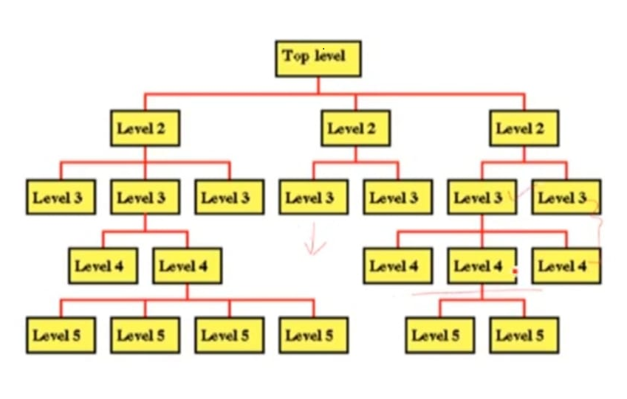
Structured /Functional Paradigm
Focus on procedures and functions
Design the system by decomposing it based on the process and functions
Top-down algorithmic decomposition

Slide 24
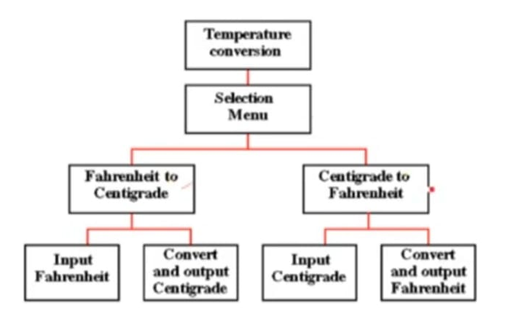
Structured /Functional Paradigm
Example of a temperature converter

Slide 25
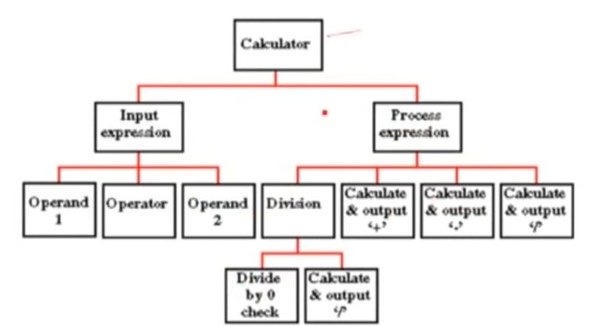
Structured /Functional Paradigm
Example of a calculator

Slide 26
Structured /Functional Paradigm (Drawbacks)
Interdependencies between various functions and processes
Cannot be reused easily
Data related to each function is not attached

Slide 27
Object Oriented Paradigm
Describing the software solution in terms of collaborating objects, with responsibilities.
- Objects
- Classes
- Encapsulation
- States
- Inheritance
- Composition
- Polymorphism

Slide 28
Object Oriented Paradigm
Bottom-up approach
- Encapsulate data and procedures in objects and classes
- Refinement in classes lead to composition od a larger system
Benefits
- enjoy all benefits of modular approach
- dependencies can be handled by finding the commonalities through inheritance and polymorphism

Slide 29
Object Oriented Paradigm
Benefits
- naturalness as object oriented paradigm models the real world better because everything in real world is an object
Limitation
- if OO design is incorrect, the implementation derived from the design in an OOP language would be complex

